Slide 1


DataWizards
December
2025
Healthcare Presentation
Healthcare
Industry
Finding insights at Every Step

Slide 2
Healthcare organizations today rely heavily on data to improve patient outcomes, enhance clinical quality, and optimize operational efficiency.
This project focuses on analyzing healthcare data to evaluate key clinical performance indicators, identify trends, and support evidence-based decision making. By transforming raw clinical data into meaningful insights, the analysis highlights areas of strength, uncovers potential quality gaps, and provides actionable recommendations to support better patient care and overall healthcare performance.
Your Health,
Our Priority
This analysis specifically centers on key clinical quality indicators such as Average Length of Stay, 30-day readmission rates, laboratory test result patterns, medication effectiveness, and condition recovery rates. These KPIs were derived from core healthcare data sources including electronic health records, admission–discharge data, laboratory systems, and medication records. By examining these measures, the project provides a comprehensive view of treatment effectiveness, patient safety, and care efficiency, enabling healthcare stakeholders to monitor performance, identify improvement opportunities, and support data-driven clinical decisions.
Next Page

Slide 3
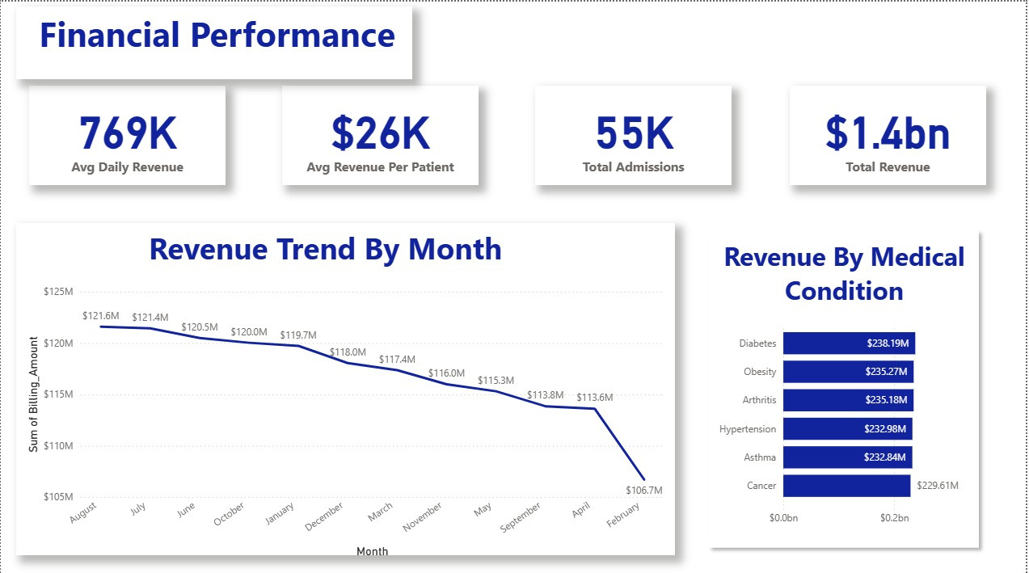
Financial Analysis

Slide 4
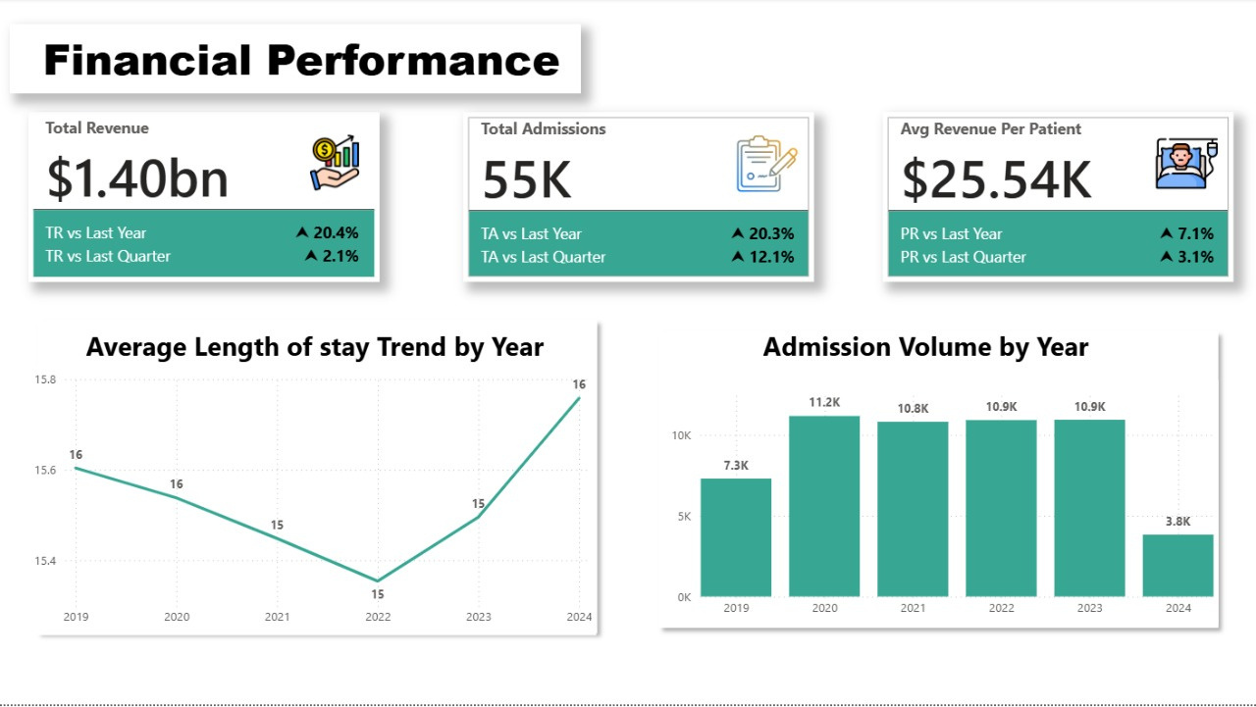
Financial Analysis

Slide 5
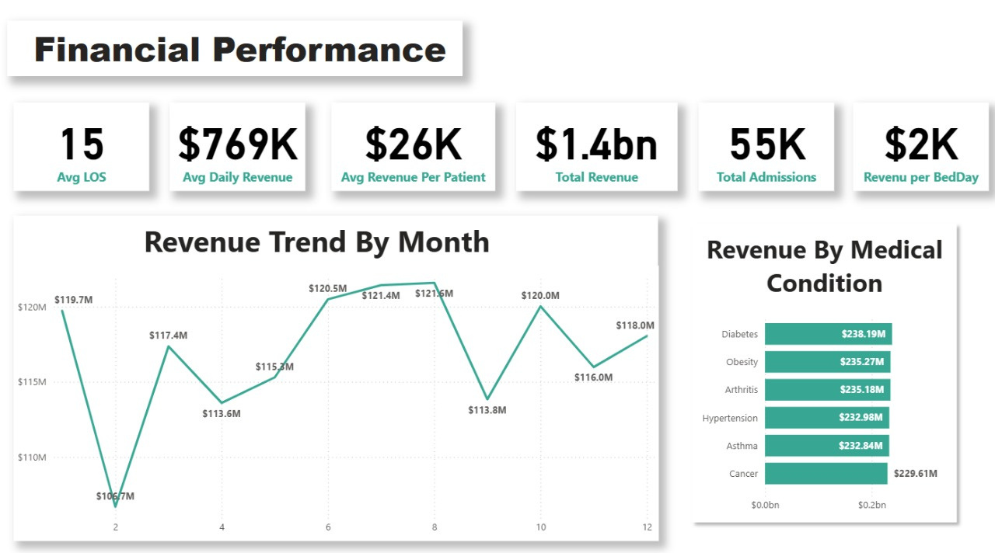
Financial Analysis

Slide 6


Financial Findings
The dashboards show strong overall financial performance, with total revenue at $1.4B, supported by high average daily revenue ($769K) and revenue per patient (about $26K). Year-over-year revenue growth exceeds 20%, indicating solid demand and effective service delivery.
Monthly and yearly trends reveal some fluctuations, with revenue peaking above $120M in several months and dipping to around $106M in others. Admissions remain steady at 55K, and the average length of stay shows an upward trend, rising to 16 days in 2024.
Revenue by medical condition highlights that chronic diseases—such as Diabetes, Obesity, Arthritis, Hypertension, Asthma, and Cancer—each generate over $229M. This confirms that long-term condition management is a major driver of financial performance.

Slide 7
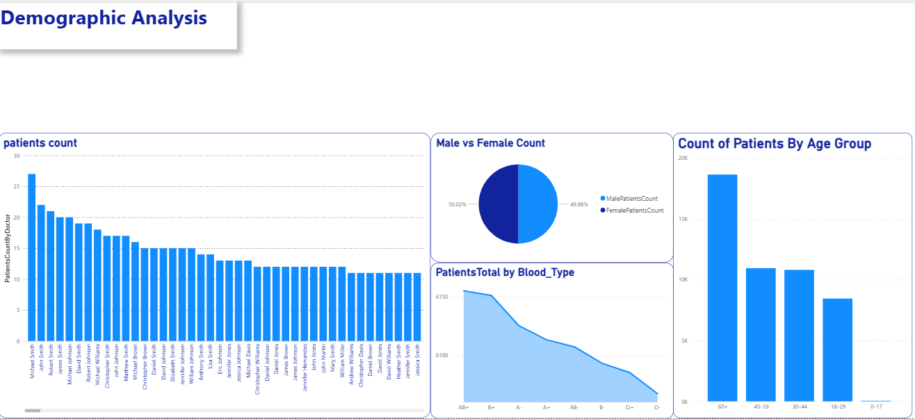
Patient-Centered
Demographic Analysis

Slide 8
Executive
Demographic Summary
The demographic assessment provides a clear overview of the patient population across key dimensions. Patient distribution varies significantly by location, with a subset of cities contributing the highest volumes. Gender representation is balanced, indicating no substantial skew toward male or female patients. Age-group analysis shows that individuals aged 60 and above constitute the largest segment, followed by the 40–59 and 30–39 cohorts, confirming a predominantly older patient population. Blood-type data follows expected national patterns, with common types such as A+ and O+ comprising the majority and rarer types appearing in lower frequencies. Collectively, these insights highlight a geographically concentrated, age-advanced, and gender-balanced patient base, offering a strong foundation for targeted healthcare planning and resource allocation.
Next Page

Slide 9
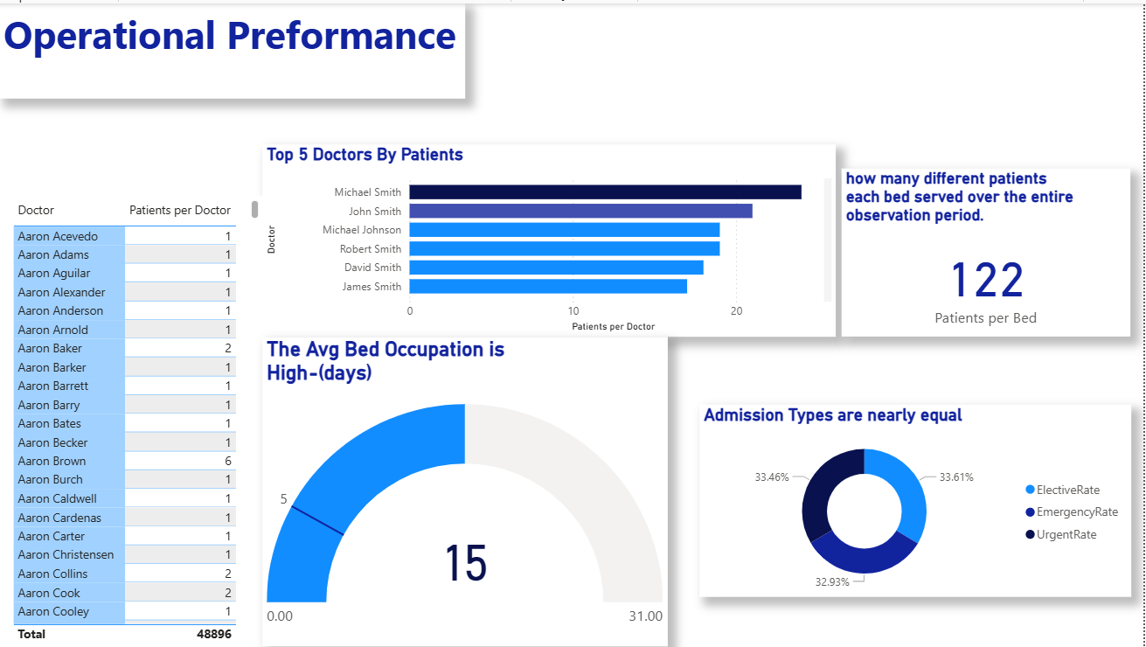
Operational Analysis

Slide 10
In contrast, the majority of doctors handle 1–2 patients each, highlighting a pronounced workload imbalance across the care team.
Bed utilization metrics reflect similarly high pressure. The average bed occupancy stands at 15 days, indicating prolonged patient stays and reduced turnover capacity. Over the full observation period, each bed served 122 different patients, emphasizing the heavy reliance on limited bed resources and the operational strain this places on inpatient care.
Admission patterns are evenly distributed across categories, with Elective (33.61%), Emergency (33.46%), and Urgent (32.93%) admissions showing an almost perfect balance. This distribution suggests that the hospital manages a broad and consistent mix of case severities without significant seasonal or categorical skew.
Collectively, these findings underscore a system facing high throughput, uneven provider workload, long bed occupancy durations, and balanced but continuous admission demand—all of which should inform capacity planning, workforce allocation, and efficiency optimization strategies.
Executive operations Summery
Operational performance indicators reveal a system operating under substantial demand, with clear patterns in physician workload, bed utilization, and admission behavior. The top-performing physicians manage significantly higher patient volumes than the broader provider base:
  Michael Smith: ~21 patients
  John Smith: ~18 patients
  Michael Johnson: ~16 patients
  Robert Smith: ~15 patients
  David Smith: ~14 patients

Slide 11
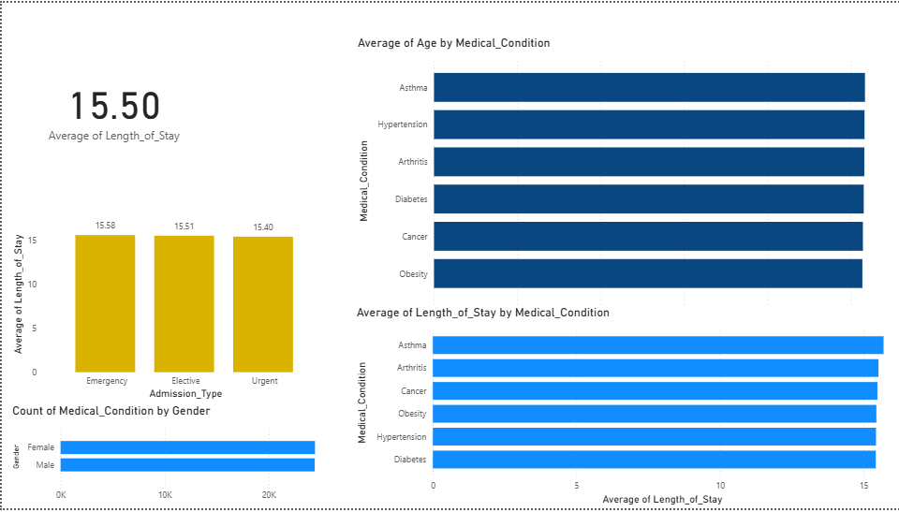
Clinicl Analysis

Slide 12
Length of stay by medical condition shows slightly greater differentiation. Patients with asthma experience the longest stays—approximately 16 days—followed closely by those with arthritis, cancer, obesity, hypertension, and diabetes, all of which align near the 15–16 day range. This indicates that while conditions differ in complexity, their inpatient resource demands remain comparable.
Gender distribution across medical conditions is balanced, with male and female counts appearing nearly identical for all major diagnoses. This balance suggests that the clinical caseload is not significantly skewed toward one gender.
Overall, the data reflects a consistent and predictable clinical profile, characterized by similar patient ages, stable length-of-stay patterns across conditions, and balanced gender distribution—providing a reliable baseline for forecasting resource utilization and care planning.
Executive Clinical
Summery
The clinical data analysis highlights consistent patterns in patient age distribution, length of stay, and condition prevalence across genders. The overall average length of stay (LOS) is 15.50 days, with minimal variation across admission types:
  Emergency: 15.58 days
  Elective: 15.51 days
  Urgent: 15.40 days
This narrow range indicates that LOS is largely driven by medical condition rather than admission type.
Age distribution across clinical conditions is stable, with average ages clustering closely together. Patients with asthma, hypertension, arthritis, diabetes, cancer, and obesity all fall within a similar age band, suggesting a relatively uniform age profile across chronic and acute conditions.

Slide 13
DataWizards
Becember
2025
Healthcare Presentation
Thank
You
Finding insights at Every Step

